Slide 1

Winning the War on Talent!
Highlights for a successful talent development and retention plan
Chittenden Group Meeting – September 2022

Slide 2

Meet your presenter:
Allison Ebner
VP, Member Relations & Partnerships
Employers Association of the NorthEast
www.EANE.org
aebner@eane.org

Slide 3

Our Current Landscape
KEY FACTS: THE PERFECT STORM
High baby boomer retirements – Boomerangs are it!
Lower birth rates – Less children being born
Gen X – Smallest generation! Not enough of us!
Candidate choice – Jobs are plentiful right now…Hmmm
Opioid crisis – High toll on males 24-54
Migration out of New England states – Moving south and west
Compensation is rising – Companies under prepared
Quiet Quitting – Let’s discuss! The silent business killer
Culture, culture, culture – What’s your EVP? (Employee Value Proposition!)
Notes:
Baby Boomers retired in record numbers! Bright spot: some are coming back into the workforce! Boomerangs!
80 million boomers retired or getting ready to retire. 45 million Gen X’ers in the workforce. Do the math!
Perfect storm of things happening!

Slide 4
A few definitions…
Total Rewards
Employee Value Proposition
Total Employee Experience
Anything the employer offers in return for employees’ membership, commitment, and contribution. The narrow definition of total rewards has been compensation, benefits, well-being, recognition and development.
The promise an employer makes to its employees detailing what the employer will provide to employees when they bring their skills, experience and commitment to the workforce.
The worker's perceptions about his or her journey through all the touchpoints at a particular company, starting with job candidacy through to the exit from the company.
Notes:
This is what the big companies are talking about. You should know it too!
Your EVP plus your total rewards package = Your employee experience

Slide 5
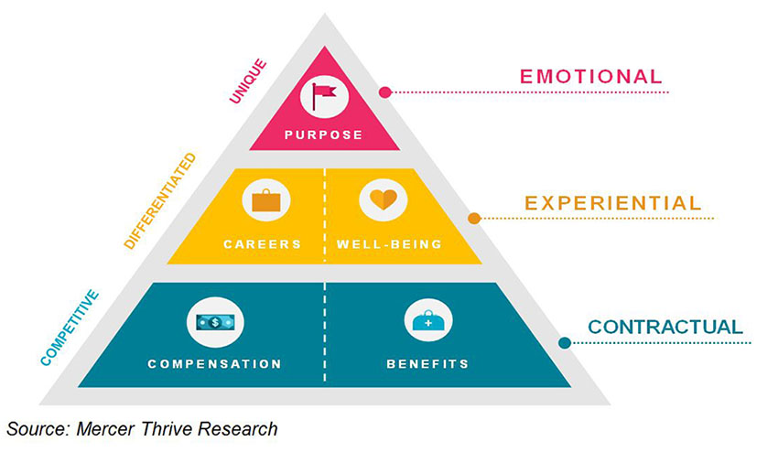
Components of the Employee Value Proposition
Notes:
Examples of contractual: health insurance, compensation, paid sick time (paid leave)
Examples of well-being: EAP, fitness apps, lifestyle account, training & development, job shadowing, career pathing
Examples of Purpose: Feeling connected to the mission, vision, values of the organization. NASA example!

Slide 6
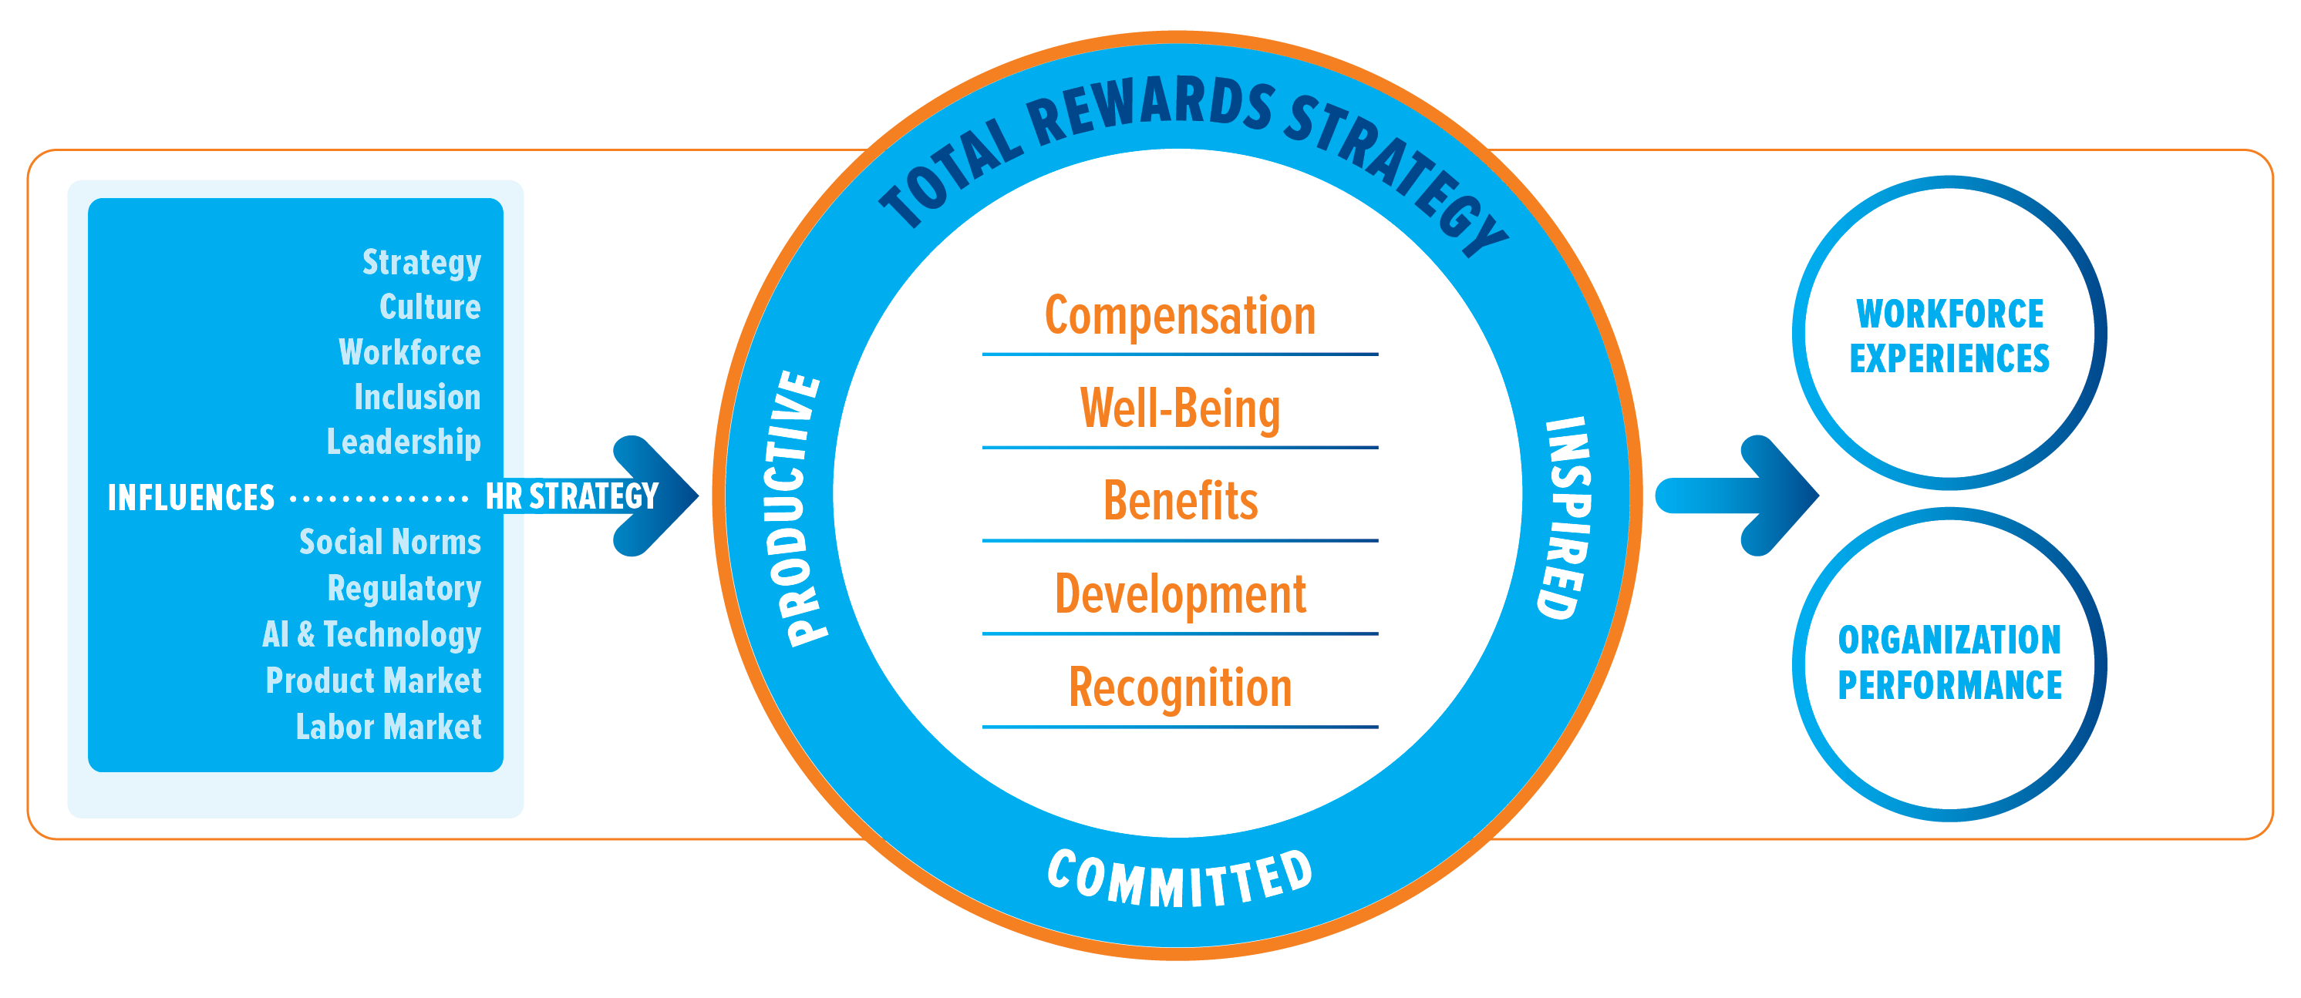
The Total Rewards Model
World at Work
Notes:
World at Work
Quarterly is the new Annual – We must move quicker! Performance mgmt, benefit review, employee surveys
Must connect people to the mission, vision and values.
Celebrate, appreciate and recognize

Slide 7
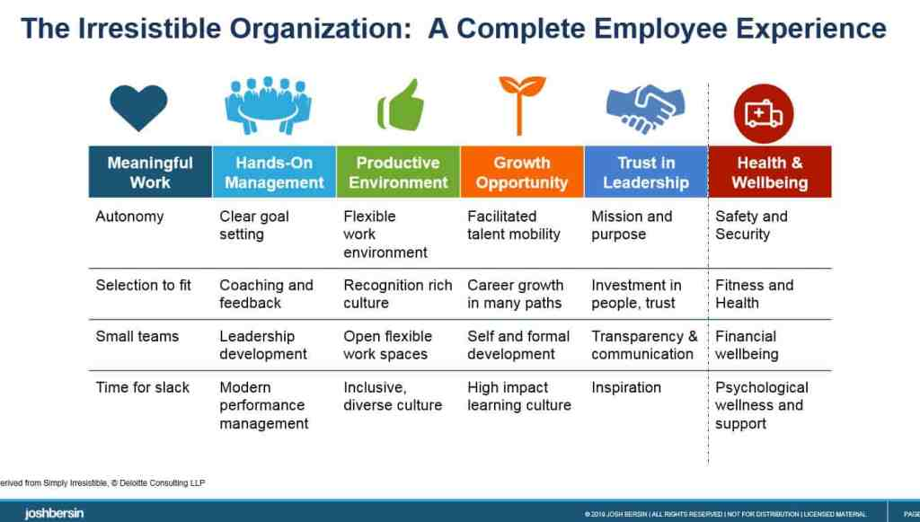
The End Game!

Slide 8
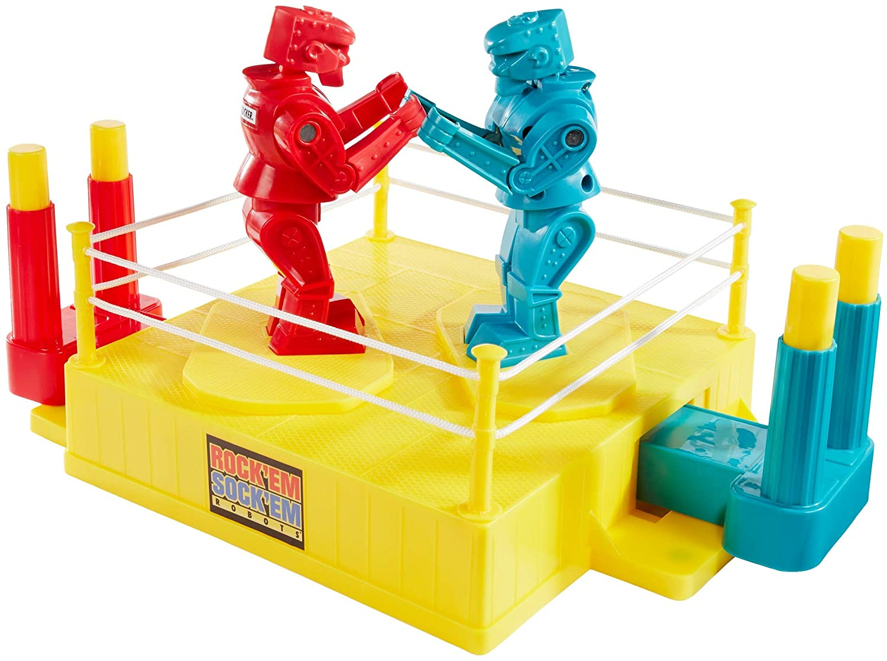
Empathy AND Accountability
Notes:
These should not be dueling priorities in your organization. They should be intertwined and given equal weight and focus.
WHY?
If you use transparency and empathy – clearly stating your goals and objectives – you can hold people accountable.

Slide 9
Weathering the Storm: Retention and Quiet Quitting
HIGH COST OF EMPLOYEE TURNOVER AND RETRAINING!
Identify the top performers! Use stay interviews, not exit interviews
Present realistic job descriptions – Detailed performance reviews
Offer Coaching to improve performance: Build strong leaders that will build trust and can hold people accountable
Establish strong onboarding, mentoring and training programs
Be flexible where you can – Adapt to change
Communicate frequently and be open and TRANSPARENT!
QUIET QUITTING – LEARN HOW TO RECOGNIZE THE SIGNS!
Notes:
In summary Retention Matters!
Help your top performers stay and they will help you!
Presenting realistic job descriptions – turnover tends to be highest among new hires
Consider Coaching for employee’s that are struggling – give them the tools to improve and stay
What is Quiet Quitting? 21% of workers surveyed said that they only do the bare minimum to fly under the radar.
52% think that their employer has noticed and don’t care!
Productivity is down at the national level Q1 2022 – 7.4% and Q2 4.6%

Slide 10
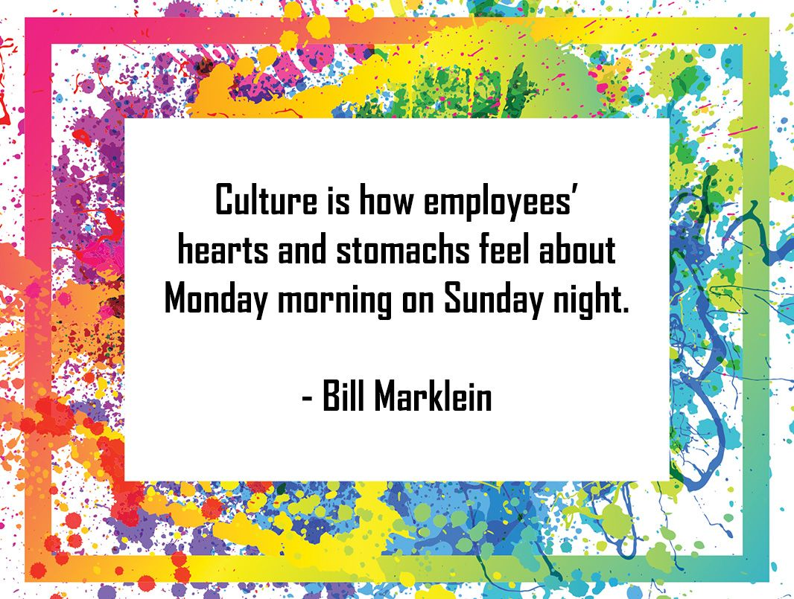
Adapting our Organizations:
Notes:
February 2020 is NOT the same as September 2022. VERY different.
Employees are in the drivers seat. The employment currency has changed.

